Slide 1
Optimize your Sample Preparation Workflow for PFAS Analysis

Slide 2
Optimize your Sample Preparation Workflow for PFAS Analysis
Automate the Sample Prep Workflow
Automate the Solid Phase Extraction Step
Automate the Concentration/Evaporation Step
Automated, Semi-Automated SPE Extractions and Concentration
Reduces Human Error
Reduces Outside contamination
Increase Throughput
Reduces Labor
No Teflon
Use Hyphenated techniques to deliver consistent, reproducible results
Different configurations to handle Matrix type and Budget
Use any size cartridge

Slide 3
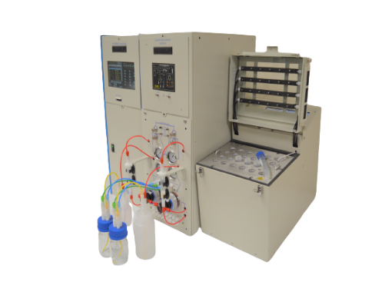
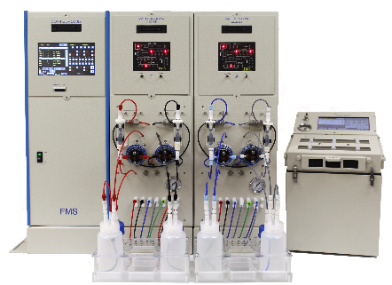
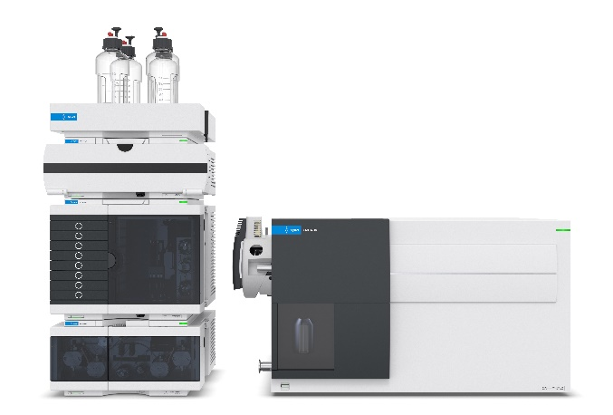
Automated Solid Phase Extraction front end for LC/MS
EconoTrace® PFC
Drinking Water Methods
TurboTrace® PFC
Modular and Expandable
Designed for Different Matrices and Number of Samples to be run per week
LC/MS

Slide 4
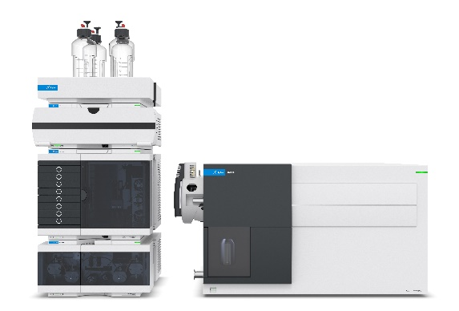
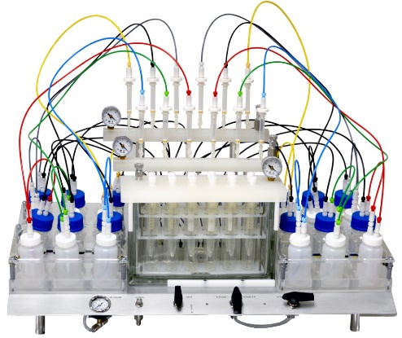
Semi-Automated Solid Phase Extraction PFAS/PFOS front end for LC/MS
EZPFC / SuperVap PFC 24
LC/MS
Low Cost, High Throughput Sample Prep

Slide 5
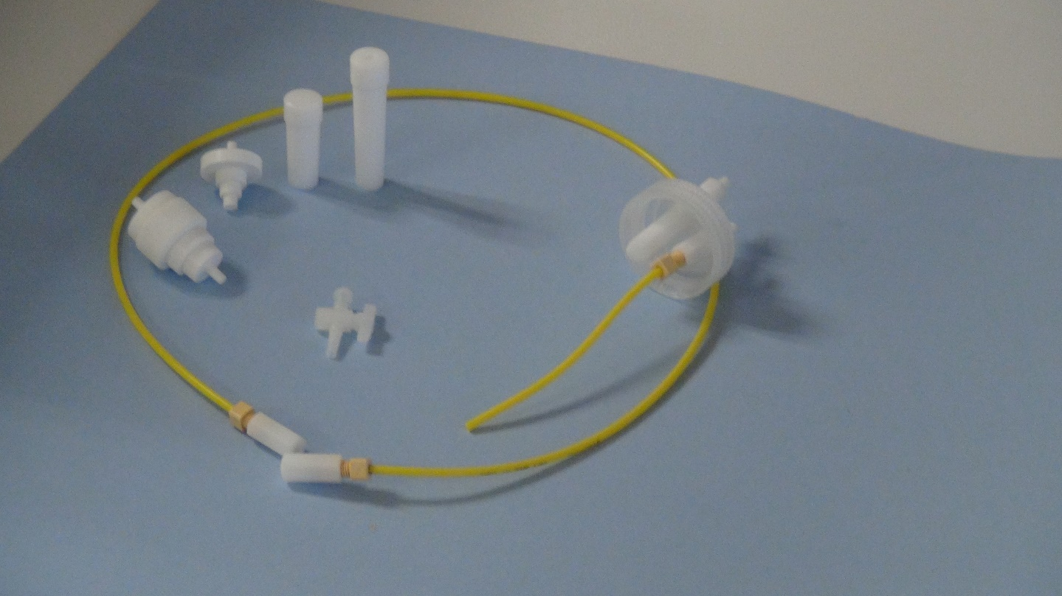
System Components
No Teflon
Tubing - High Density Polyethylene
Fittings – Delrin
Cartridge Adapters – Medical Grade Polypropylene

Slide 6
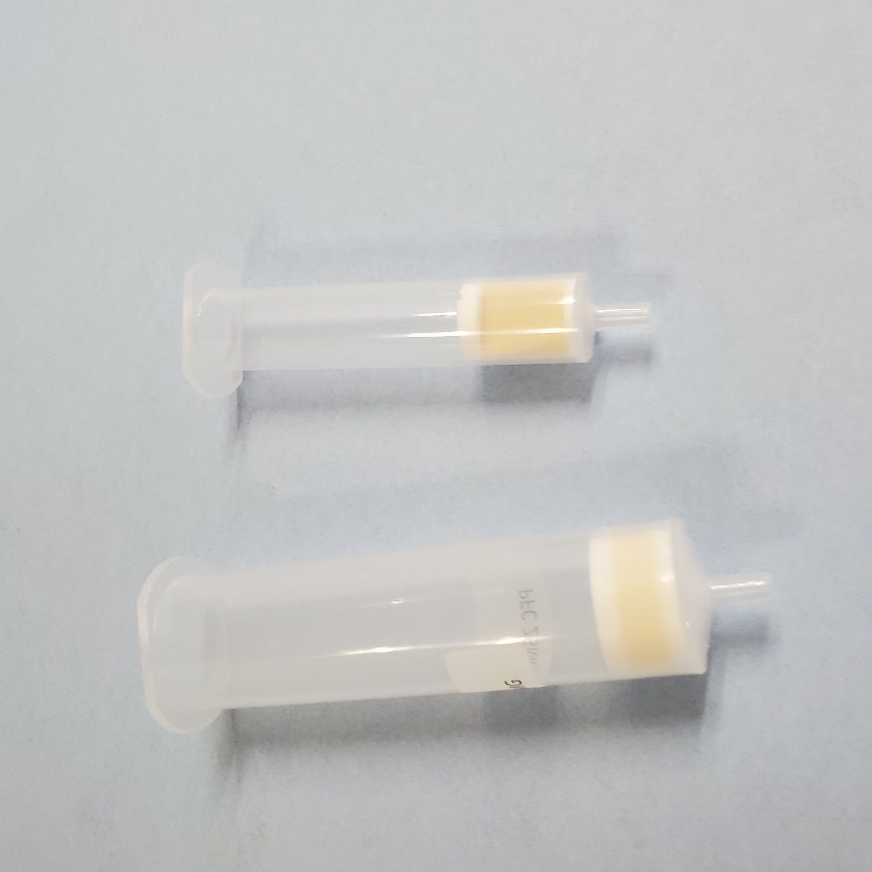
Can this Handle Dirty Samples?
Typical Cartridge can have problems!
6ml cartridge
Doesn’t do well
Frit Surface Area is to small
Yes, A Cartridge will work
25ml cartridge
Does well
3X the Frit Surface Area

Slide 7
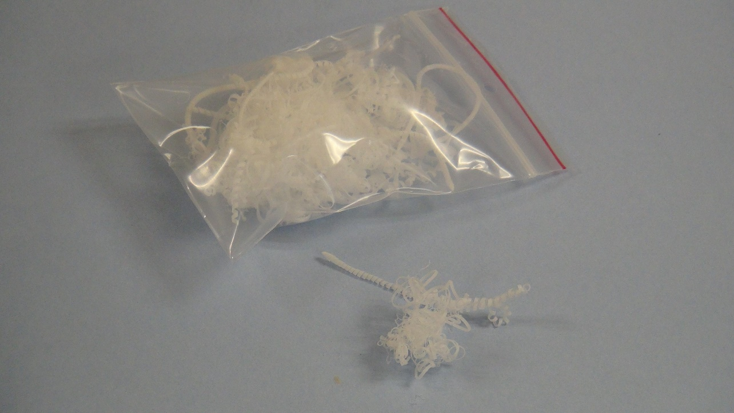
FMS, Inc. Plastic Filtration Wool
Glass/Plastic Wool
Irregular random stranding
Slows Particles to the Uniform Frit
Prevents Clogging

Slide 8
Prepping the 6ml Cartridge with Plastic Filtration Wool
6ml Cartridge with Plastic Wool
Take a little and push it into the barrel of the syringe until it touches the cartridge Frit
The Sample will not clog, it will take longer to process

Slide 9
Live Instruments

Slide 10
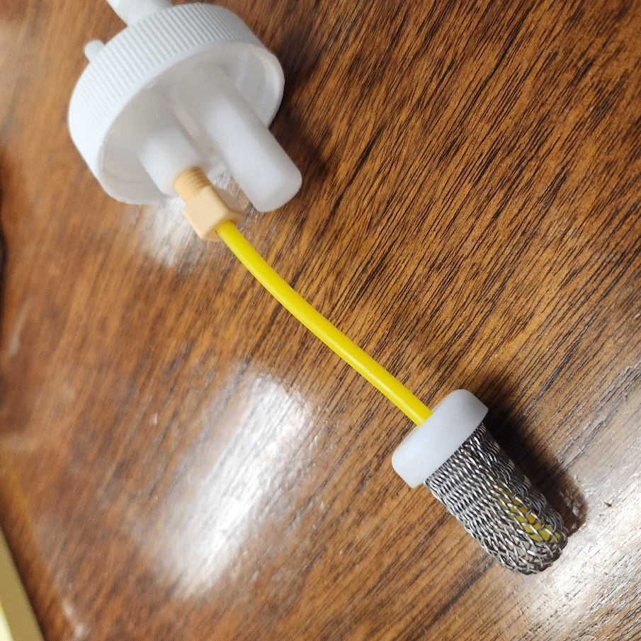
Sample Bottle Filter

Slide 11
Dirty Sample from a Customer

Slide 12
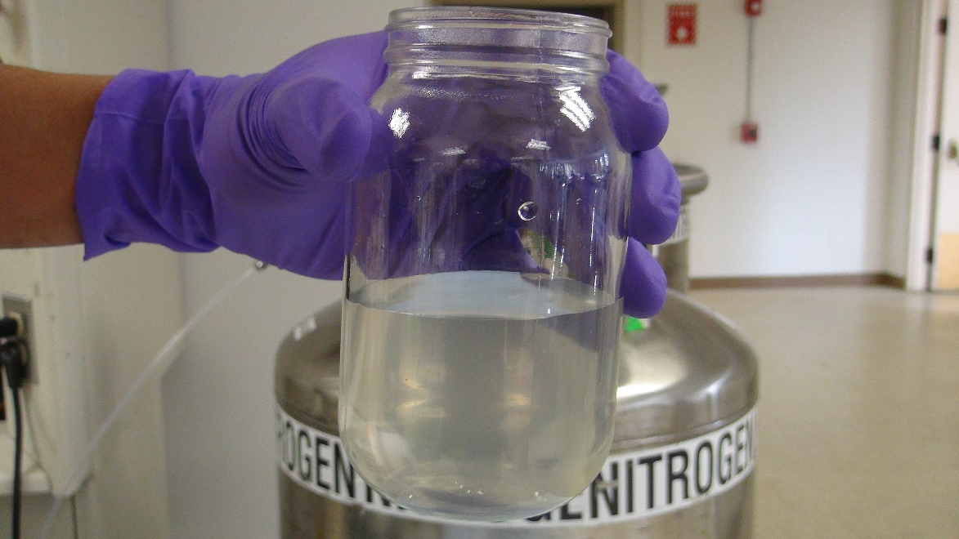
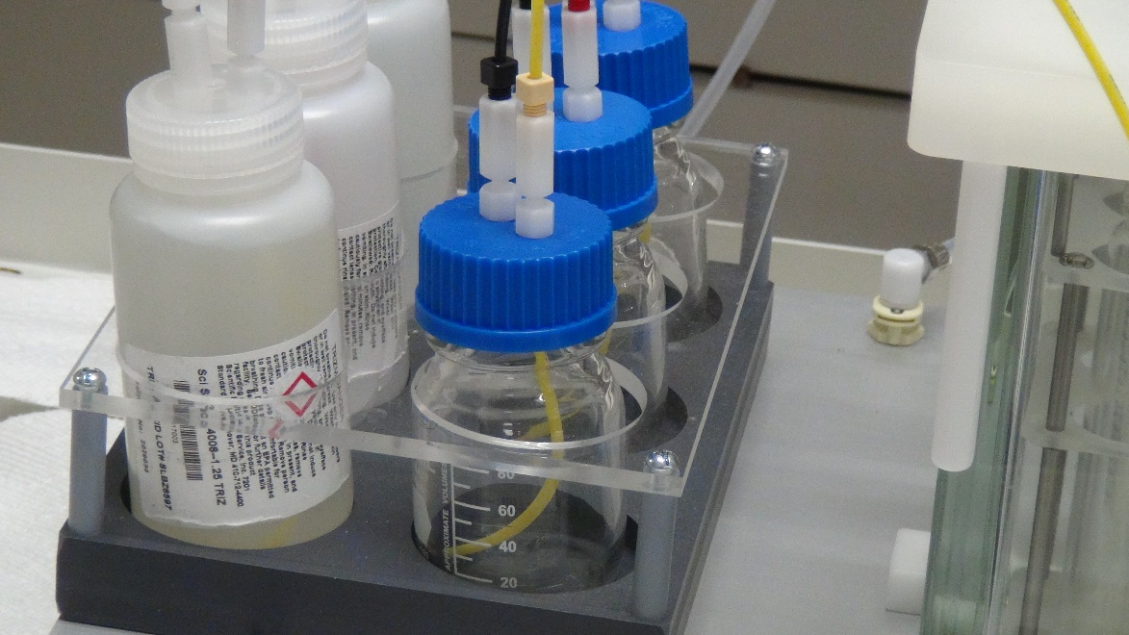
Industrial 433 Matrix 250ml

Slide 13
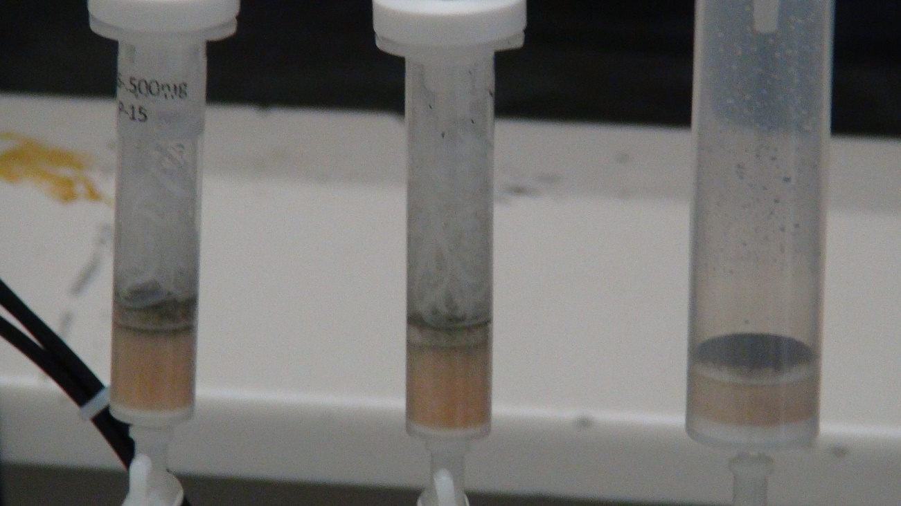
6ml and 25ml Cartridges

Slide 14
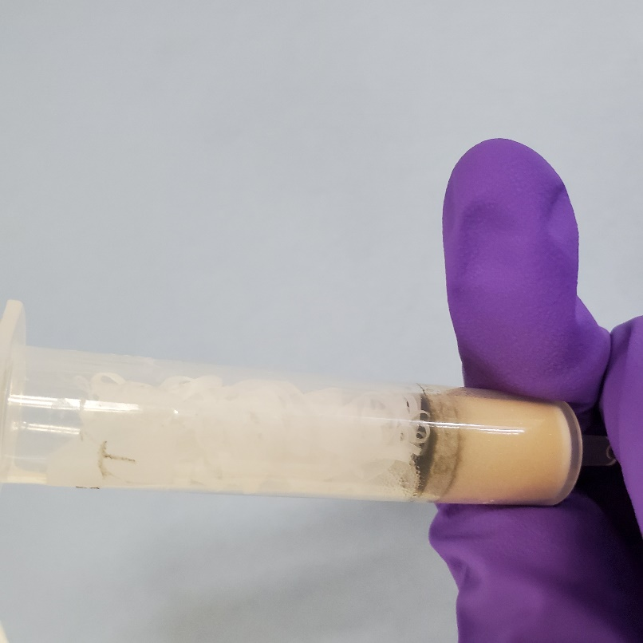
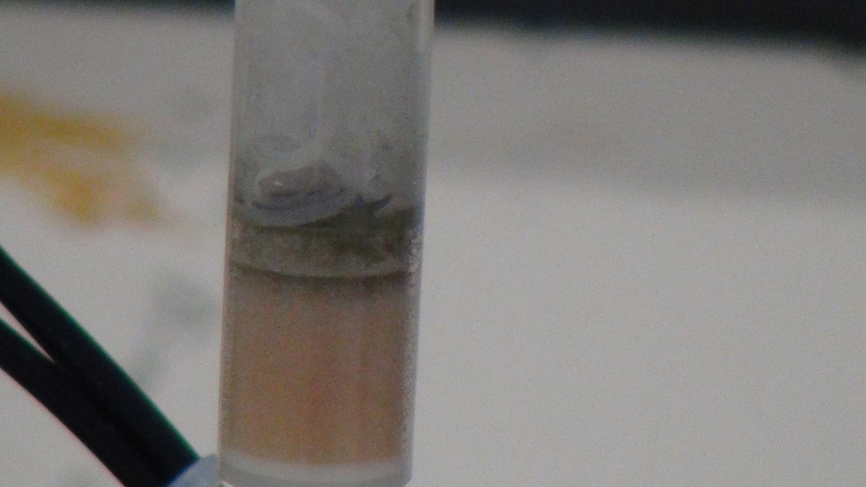
250 ml run to completion on 6 ml cartridge with Plastic Wool

Slide 15
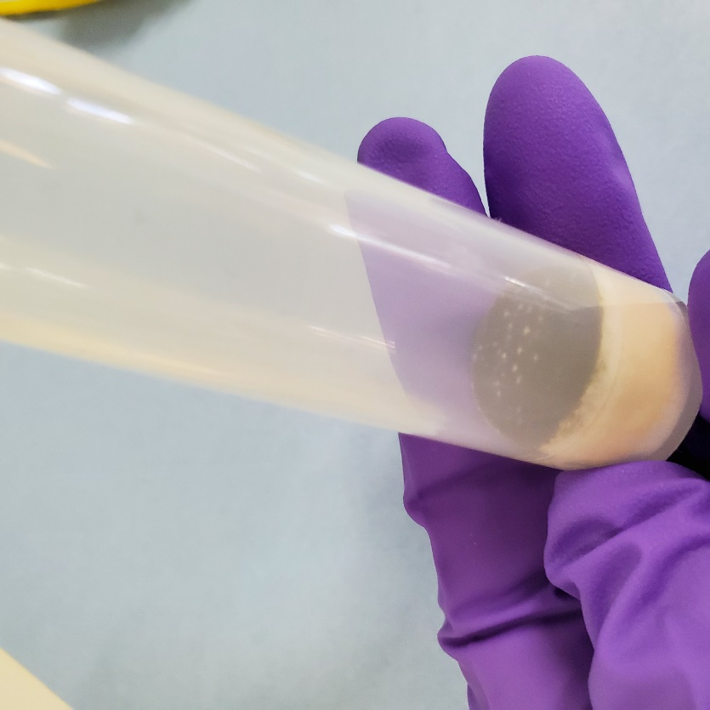
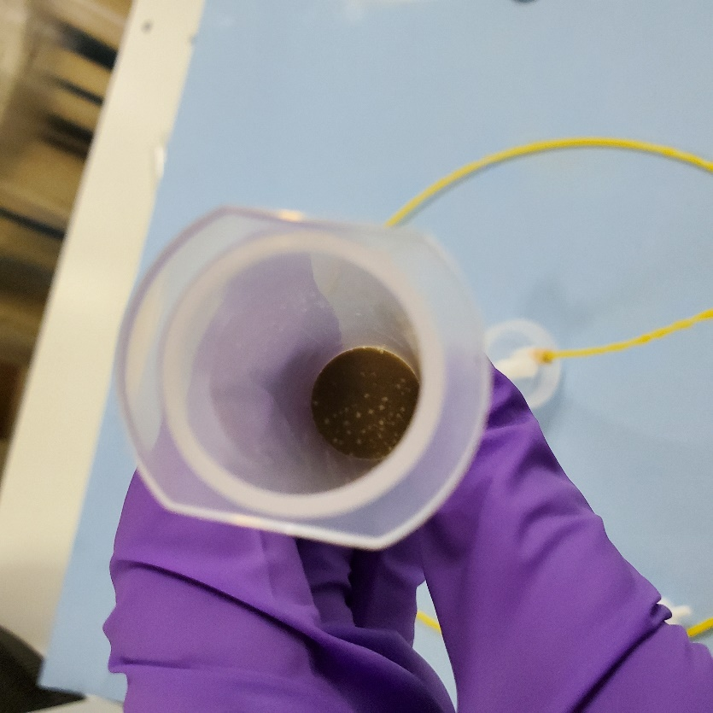
250ml run to completion 25ml cartridge

Slide 16
TurboTrace PFC Automated Extraction and Concentration for PFAS/PFOS in Drinking Water and WasteWater
TurboTrace® PFC
Wastewater, Particulate Laden Samples
Drinking water Samples
Vacuum Pump or Positive Pressure for loading samples
Positive Pressure Pumping for conditioning, rinsing and elution
Direct to SuperVap Concentrator
LC/MS

Slide 17
TurboTrace for Extraction and Concentration of PFAS/PFOS in Drinking/WasteWater
Fully Automated from start to finish
Modular and Scalable expandable from 1 to 4 Modules
Run 2 to 8 samples
Each Module can Run 2 Samples in parallel
Uses Positive Pressure Pumping
for Precise delivery of Elution and Wash Solvent
One valve pathway to the cartridge
Uses a Vacuum with liquid sensor to Load Dirty Samples and detect when finished
Direct Extract delivery to Concentrator for Evaporation

Slide 18
Drinking Water
ORG
RNS
Pressure Tr.
N2
CRT
SAM
BYPS
Wastewater
Pump
30psi
5psi
Sample
Rinse
30psi
Regulators
Solvents 1-6
5psi
Fraction
FRC
OW
AQW
New SPE-Turbo
Vacuum
pump
Automated 1633 EPA method:
Organic
Waste
Aqueous
Waste

Slide 19
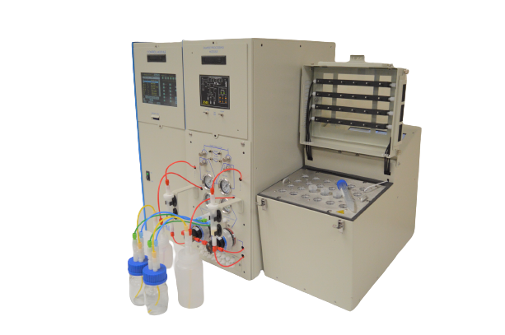
Automated Extraction and Concentration for PFAS/PFOS in Drinking Water
EconoTrace® PFC
Drinking Water, Serum, and samples with minimal particulate
Positive Pressure Pumping
LC/MS

Slide 20
EconoTrace SPE
Touch Screen Control
SD Card for Storing and Transferring Methods
Nitrogen Drying
Six Elution and Wash Solvents
Automatic Bottle Rinse
Direct to 15 ml Centrifuge tube Concentration
Sample Size 2 ml to unlimited

Slide 21
EconoTrace for Extraction and Concentration of PFAS/PFOS in Drinking Water
Fully Automated
Modular and expandable from 1 to 4 Modules, 2 to 8 samples
High Throughput Runs
8 Sample Extractions in Parallel
Uses Positive Pressure Pumping only
for Precise delivery of
Conditioning Solvent,
Sample, Bottle Rinse and Elution Solvent
Automatic Bottle Rinse
Delivers extract directly to SuperVap Concentrator for final blowdown

Slide 22
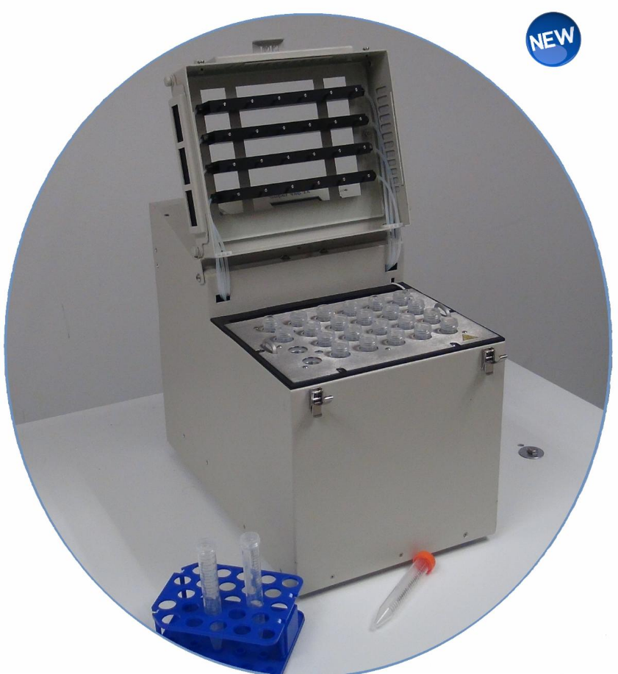
Automated Concentration for PFAs
SuperVap PFC
24 positions
15ml Conical vials
No Teflon

Slide 23
EPA 537.1

Slide 24
EPA 533

Slide 25
PFAS Background
Compound | Amount Spiked ng/L |  | Mean Percent Recovery | Background from FMS SPE
Perfluorinated Compounds | 50 ng/L |  |  | 50 ng/L
PFHxA |  | 61% |  | 0.068
PFHxS |  | 77% |  | 0.06
PFOA |  | 88% |  | 0.214
PFNA |  | 74% |  | 0.062
PFOS |  | 72% |  | 0.048
PFDA |  | 84% |  | 0.054
PFUdA |  | 65%
PFDoA |  | 57% |  | 0.011

Slide 26
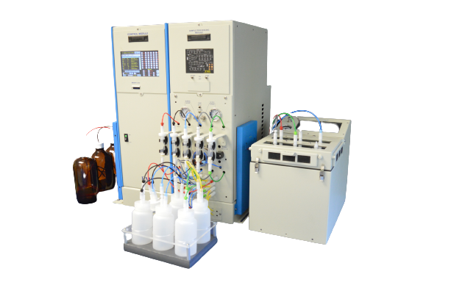
TurboTrace Parallel Sequential PFC Automated Extraction and Concentration for PFAS/PFOS in Drinking Water and WasteWater
TurboTrace® PFC Parallel Sequential
Wastewater, Particulate Laden Samples
Drinking Water Samples
Vacuum Pump or Positive Pressure for loading samples
Positive Pressure Pumping for conditioning, rinsing, and elution
Direct to SuperVap Concentrator
LC/MS

Slide 27
TurboTrace for Extraction and Concentration of PFAS/PFOS in WasteWater
Fully Automated
Modular and Scalable expandable from 1 to 6 Modules
Run 1 to 6 samples simultaneously, up to 30 sequentially
Each Module can Run 5 Samples in a Sequence
Uses Positive Pressure Pumping
for Precise delivery of
Elution and Wash Solvent
Uses Vacuum with liquid sensor to Load Dirty Samples
Direct Extract delivery to Concentrator for Evaporation

Slide 28
1633 Parallel-Sequential Recoveries (n=5)

Slide 29
Concentration Functionality
Designed for PFAS/PFOS Concentration
Accepts Extracts Directly from FMS Automated SPE systems
Self Installable
Video unpacking, installation and training video
Preprogrammed with most common temperature settings
Direct to 15ml Centrifuge Tubes
Dry bath heating element
Time based endpoint

Slide 30
Semi-Automated Solid Phase Extraction front end for LC/MS
EZPFC
LC/MS

Slide 31
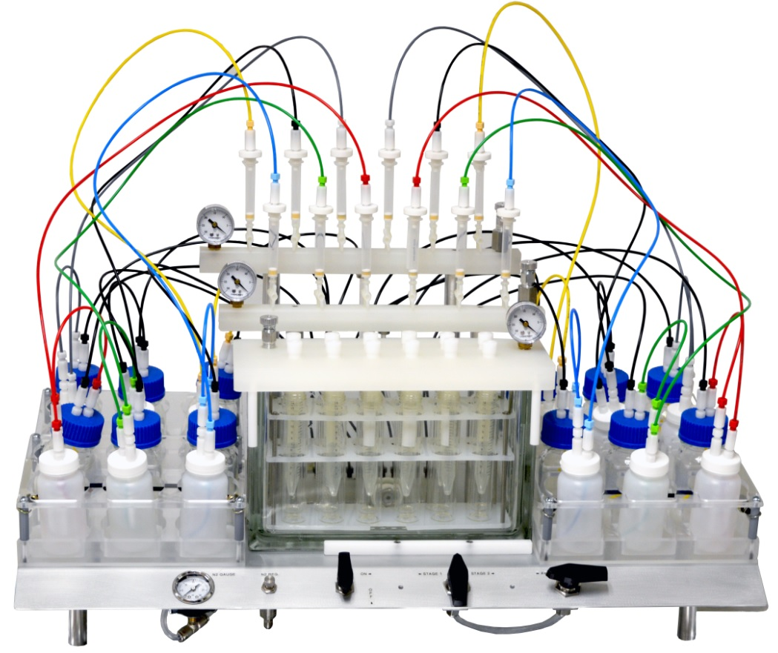
EZPFC®
Drinking Water,
Wastewater,
Particulate laden samples
EZPFC 12 sample

Slide 32
EZPFC Semi Automated SPE
Low Cost
Run and Concentrate a batch of 24 samples 2 to 3 hours
Self Installable
Unpacking and Installation/training video
Easy to Operate
No Computers or Electronics to fail or maintain
Semi - Automated
Hyphenates the entire Solid Phase Extraction Process – Extraction, Bottle Rinse, Inline Drying and Direct to 15ml Centrifuge tube for easy Concentration
Fast
The fastest sample processing available for SPE
Run up to 12 samples simultaneously
Vacuum for fast loading of large volume samples
Unattended Sample loading walkaway time
Closed system
Eliminate potential outside contamination

Slide 33
EZPFC Semi Automated SPE
Efficient
Uses all SPE cartridge sizes
Dedicated manifold for cartridge conditioning and sample loading
Dedicated manifold for extraction and extracts
Separates Organic from Aqueous waste
Vacuum cartridge drying, Nitrogen cartridge drying or combined
Automated Bottle Rinse and Elution
Inline Extract Drying
Small number of components to clean

Slide 34
1633 EZPFC labeled surrogate recoveries
Surrogate Recovery with EZPFC
1633 order | 230131 RT Order | Surrogate | EZPFC Avg Recovery | EZPFC %RSD
1 | 1 | 13C4-PFBA | 111 | 6%
2 | 2 | 13C5-PFPeA | 116 | 6%
3 | 4 | 13C5-PFHxA | 110 | 6%
4 | 7 | 13C4-PFHpA | 110 | 7%
5 | 9 | 13C8-PFOA | 107 | 6%
6 | 11 | 13C9-PFNA | 109 | 8%
7 | 13 | 13C6-PFDA | 106 | 9%
8 | 17 | 13C7-PFUnA | 104 | 10%
9 | 18 | 13C2-PFDoA | 93 | 10%
10 | 19 | 13C2-PFTeDA | 83 | 12%
11 | 5 | 13C3-PFBS | 106 | 6%
12 | 10 | 13C3-PFHxS | 105 | 11%
13 | 16 | 13C8-PFOS | 110 | 8%
14 | 3 | 13C2-4:2FTS | 99 | 15%
15 | 8 | 13C2-6:2FTS | 97 | 16%
16 | 12 | 13C2-8:2FTS | 105 | 19%
17 | 20 | 13C8-PFOSA | 142 | 15%
18 | 22 | D3-NMeFOSA | 114 | 12%
19 | 24 | D5-NEtFOSA | 70 | 16%
20 | 14 | D3-NMeFOSAA | 103 | 9%
21 | 15 | D5-NEtFOSAA | 111 | 14%
22 | 21 | D7-NMeFOSE | 87 | 6%
23 | 23 | D9-NEtFOSE | 76 | 10%
24 | 6 | 13C3-HFPO-DA | 111 | 7%

Slide 35
1633 natives IDC spikes concentrations and recoveries
 |  | In ng/L |  |  |  |  | Native spike recovered (%)
Name | Target Amount ng/L | IDC-1 | IDC-2 | IDC-3 | IDC-4 |  | IDC-1 | IDC-2 | IDC-3 | IDC-4 |  | Average | STDEV | RSD(%)
11Cl-PF3OUdS | 8.7 | 8.69 | 8.39 | 8.78 | 9.04 |  | 100 | 97 | 101 | 104 |  | 100 | 3.1 | 3.1
3-3 FTCA | 9.7 | 8.21 | 9.66 | 9.45 | 9.26 |  | 84 | 99 | 97 | 95 |  | 94 | 6.6 | 7.0
4-2 FTS | 9.6 | 9.53 | 9.39 | 8.96 | 8.84 |  | 99 | 98 | 93 | 92 |  | 96 | 3.4 | 3.6
5-3 FTCA | 52.0 | 48.65 | 52.44 | 52.01 | 52.74 |  | 94 | 101 | 100 | 101 |  | 99 | 3.7 | 3.7
6-2 FTS | 9.7 | 9.20 | 9.53 | 9.38 | 9.48 |  | 95 | 98 | 97 | 98 |  | 97 | 1.5 | 1.5
7-3 FTCA | 49.6 | 45.57 | 48.85 | 50.91 | 50.80 |  | 92 | 98 | 103 | 102 |  | 99 | 5.0 | 5.1
8-2 FTS | 10.0 | 8.65 | 9.39 | 10.08 | 9.85 |  | 86 | 93 | 100 | 98 |  | 94 | 6.3 | 6.7
9Cl-PF3ONS | 9.4 | 9.60 | 9.00 | 9.35 | 9.30 |  | 103 | 96 | 100 | 99 |  | 100 | 2.6 | 2.6
ADONA | 8.0 | 8.25 | 7.73 | 8.26 | 8.03 |  | 103 | 96 | 103 | 100 |  | 100 | 3.1 | 3.1
EtFOSE | 23.9 | 22.60 | 22.30 | 25.24 | 24.09 |  | 95 | 93 | 106 | 101 |  | 99 | 5.7 | 5.8
HFPO-DA | 9.3 | 9.31 | 9.34 | 9.24 | 9.34 |  | 100 | 100 | 99 | 100 |  | 100 | 0.5 | 0.5
MeFOSE | 21.6 | 21.94 | 22.76 | 23.26 | 22.26 |  | 102 | 106 | 108 | 103 |  | 105 | 2.7 | 2.6
N-EtFOSA | 2.0 | 2.25 | 1.84 | 2.04 | 2.19 |  | 113 | 92 | 102 | 110 |  | 104 | 9.2 | 8.8
N-EtFOSAA | 2.3 | 2.04 | 1.99 | 2.19 | 2.33 |  | 91 | 89 | 97 | 103 |  | 95 | 6.6 | 7.0
NFDHA | 5.2 | 4.51 | 4.76 | 4.97 | 4.86 |  | 87 | 92 | 96 | 94 |  | 92 | 3.8 | 4.1
N-MeFOSA | 2.4 | 2.26 | 1.95 | 2.33 | 2.27 |  | 95 | 82 | 98 | 96 |  | 93 | 7.2 | 7.8
N-MeFOSAA | 2.3 | 2.09 | 2.21 | 2.23 | 2.45 |  | 93 | 98 | 99 | 109 |  | 100 | 6.7 | 6.7
PFBA | 8.6 | 8.07 | 10.17 | 9.14 | 9.09 |  | 94 | 118 | 106 | 106 |  | 106 | 10.0 | 9.4
PFBS | 2.2 | 2.08 | 2.06 | 2.18 | 2.21 |  | 93 | 91 | 97 | 98 |  | 95 | 3.4 | 3.6
PFDA | 1.9 | 2.13 | 2.01 | 2.05 | 2.17 |  | 109 | 103 | 105 | 111 |  | 107 | 3.7 | 3.5
PFDoA | 2.3 | 2.11 | 2.30 | 2.20 | 2.45 |  | 92 | 100 | 96 | 106 |  | 98 | 6.2 | 6.3
PFDoS | 2.0 | 1.32 | 1.55 | 1.50 | 1.52 |  | 68 | 79 | 77 | 77 |  | 75 | 5.1 | 6.8
PFDS | 1.9 | 2.15 | 1.90 | 1.81 | 2.14 |  | 112 | 99 | 94 | 111 |  | 104 | 8.8 | 8.5
PFEESA | 5.2 | 4.91 | 5.12 | 5.39 | 5.41 |  | 94 | 97 | 103 | 103 |  | 99 | 4.6 | 4.6
PFHpA | 2.1 | 1.91 | 2.26 | 2.00 | 2.19 |  | 91 | 107 | 95 | 104 |  | 99 | 7.8 | 7.8
PFHpS | 2.0 | 2.24 | 2.19 | 2.08 | 2.24 |  | 110 | 108 | 102 | 110 |  | 108 | 3.7 | 3.5
PFHxA | 2.2 | 2.01 | 2.12 | 2.22 | 2.17 |  | 94 | 99 | 103 | 101 |  | 99 | 4.1 | 4.2
PFHxS | 2.2 | 1.94 | 1.93 | 2.11 | 2.13 |  | 90 | 89 | 98 | 99 |  | 94 | 5.0 | 5.3
PFMBA | 4.5 | 4.51 | 4.55 | 4.60 | 5.21 |  | 100 | 100 | 101 | 115 |  | 104 | 7.2 | 6.9
PFMPA | 4.2 | 3.56 | 4.01 | 4.10 | 3.62 |  | 85 | 96 | 98 | 87 |  | 92 | 6.6 | 7.2
PFNA | 2.2 | 1.78 | 2.07 | 2.03 | 2.41 |  | 80 | 93 | 91 | 108 |  | 93 | 11.6 | 12.4
PFNS | 2.0 | 1.93 | 2.00 | 1.83 | 2.24 |  | 98 | 101 | 93 | 114 |  | 101 | 8.8 | 8.7
PFOA | 2.3 | 1.99 | 2.21 | 2.25 | 2.31 |  | 85 | 95 | 96 | 99 |  | 94 | 6.0 | 6.4
PFOS | 1.8 | 2.10 | 1.94 | 2.09 | 2.16 |  | 116 | 108 | 116 | 120 |  | 115 | 5.1 | 4.4
PFOSA | 2.2 | 2.09 | 2.22 | 2.11 | 2.17 |  | 97 | 103 | 98 | 101 |  | 100 | 2.7 | 2.7
PFPeA | 4.3 | 4.05 | 4.23 | 4.37 | 4.52 |  | 95 | 99 | 103 | 106 |  | 101 | 4.7 | 4.6
PFPeS | 2.1 | 1.97 | 2.07 | 2.11 | 1.97 |  | 94 | 98 | 100 | 94 |  | 97 | 3.3 | 3.5
PFTDA | 2.3 | 1.97 | 1.93 | 2.00 | 2.27 |  | 86 | 84 | 87 | 99 |  | 89 | 6.9 | 7.7
PFTrDA | 2.2 | 2.48 | 2.41 | 2.85 | 2.57 |  | 113 | 110 | 130 | 117 |  | 118 | 8.8 | 7.5
PFUnA | 2.2 | 1.99 | 2.11 | 2.07 | 2.14 |  | 92 | 97 | 95 | 98 |  | 96 | 2.9 | 3.1

Slide 36
MDL data for native PFAS 1633

Slide 37
Method Detection Limit data for 1633
Compound Method |  |  |  | In ng/L
Name |  | Tareget Amount ng/L |  | MDL-1 | MDL-2 | MDL-3 | MDL-4 | MDL-5 | MDL-6 | MDL-7 | MDL-8 | MDL-9 | MDL-10 | MDL-11 | MDL-12 |  | STDEV |  | MDL
11Cl-PF3OUdS |  | 1.00 |  | 0.9757 | 0.8461 | 0.8848 | 0.8676 | 0.903 | 0.9562 | 0.9295 | 1.001 | 0.9269 | 0.8606 | 0.8928 | 0.8952 |  | 0.05 |  | 0.13
3-3 FTCA |  | 1.16 |  | 1.1076 | 1.0061 | 1.0523 | 0.7624 | 1.008 | 1.0535 | 0.8077 | 1.1272 | 0.8627 | 0.8681 | 1.1234 | 1.0782 |  | 0.13 |  | 0.35
4-2 FTS |  | 1.31 |  | 1.2138 | 1.2403 | 1.2292 | 1.12 | 1.1484 | 1.3895 | 1.2266 | 1.3185 | 1.1732 | 1.1413 | 1.3365 | 1.2441 |  | 0.08 |  | 0.22
5-3 FTCA |  | 6.26 |  | 6.4841 | 5.9048 | 5.5367 | 5.5774 | 6.0513 | 5.9923 | 5.4599 | 5.3063 | 5.4973 | 6.0996 | 5.6657 | 6.1143 |  | 0.35 |  | 0.95
6-2 FTS |  | 1.21 |  | 1.2059 | 1.1808 | 1.1303 | 1.1957 | 1.203 | 1.2985 | 1.2592 | 1.1853 | 1.2621 | 1.1807 | 1.1687 | 1.3155 |  | 0.06 |  | 0.15
7-3 FTCA |  | 6.34 |  | 6.367 | 6.1878 | 5.4119 | 5.3315 | 6.0653 | 6.2616 | 6.213 | 5.8661 | 5.2776 | 6.2892 | 6.0647 | 6.234 |  | 0.40 |  | 1.08
8-2 FTS |  | 1.33 |  | 1.2039 | 1.299 | 1.2643 | 1.389 | 1.317 | 1.1943 | 1.5686 | 1.2324 | 1.2724 | 1.2325 | 1.3068 | 1.4187 |  | 0.11 |  | 0.29
9Cl-PF3ONS |  | 1.09 |  | 1.1451 | 0.9936 | 1.0535 | 0.9826 | 1.0667 | 1.0434 | 0.9971 | 1.0751 | 1.1198 | 1.0277 | 0.9342 | 1.1701 |  | 0.07 |  | 0.19
ADONA |  | 0.89 |  | 0.9331 | 0.8955 | 0.9211 | 0.8563 | 0.8665 | 0.9005 | 0.8241 | 0.8555 | 0.8582 | 0.8953 | 0.8385 | 0.9277 |  | 0.04 |  | 0.10
EtFOSE |  | 3.06 |  | 3.1171 | 2.9492 | 2.8939 | 2.8205 | 2.7337 | 2.9667 | 3.0383 | 2.9994 | 3.5478 | 2.9956 | 3.1121 | 3.1652 |  | 0.21 |  | 0.56
HFPO-DA |  | 1.16 |  | 1.1641 | 1.3673 | 1.5113 | 1.0828 | 1.0109 | 1.0609 | 1.1359 | 1.3796 | 1.1205 | 1.2871 | 0.9968 | 1.0701 |  | 0.17 |  | 0.45
MeFOSE |  | 3.00 |  | 2.5702 | 2.7387 | 2.6963 | 2.6539 | 2.8431 | 2.9566 | 2.7913 | 2.9272 | 2.8156 | 2.5827 | 2.5617 | 2.8164 |  | 0.14 |  | 0.37
N-EtFOSA |  | 0.27 |  | 0.3248 | 0.2129 | 0.2622 | 0.2651 | 0.2489 | 0.2446 | 0.2385 | 0.2225 | 0.2738 | 0.2605 | 0.2469 | 0.3043 |  | 0.03 |  | 0.09
N-EtFOSAA |  | 0.30 |  | 0.2845 | 0.2739 | 0.2375 | 0.2527 | 0.2837 | 0.2303 | 0.2095 | 0.2888 | 0.3021 | 0.2625 | 0.2115 | 0.3256 |  | 0.04 |  | 0.10
NFDHA |  | 0.64 |  | 0.6186 | 0.619 | 0.5583 | 0.6562 | 0.6746 | 0.5904 | 0.5982 | 0.6066 | 0.574 | 0.5886 | 0.5884 | 0.625 |  | 0.03 |  | 0.09
N-MeFOSA |  | 0.31 |  | 0.2471 | 0.3268 | 0.2514 | 0.2368 | 0.2816 | 0.3739 | 0.2901 | 0.3545 | 0.3193 | 0.232 | 0.3859 | 0.3278 |  | 0.05 |  | 0.15
N-MeFOSAA |  | 0.28 |  | 0.3117 | 0.2472 | 0.2321 | 0.2977 | 0.2384 | 0.2612 | 0.2864 | 0.2534 | 0.2638 | 0.3746 | 0.2339 | 0.3021 |  | 0.04 |  | 0.11
PFBA |  | 1.08 |  | 1.0962 | 1.159 | 1.1025 | 1.0075 | 1.1083 | 1.1955 | 1.173 | 1.1283 | 1.1204 | 1.1415 | 1.172 | 1.1056 |  | 0.05 |  | 0.13
PFBS |  | 0.28 |  | 0.3285 | 0.2689 | 0.2388 | 0.2611 | 0.2751 | 0.3131 | 0.221 | 0.3002 | 0.2619 | 0.319 | 0.2321 | 0.2757 |  | 0.03 |  | 0.09
PFDA |  | 0.27 |  | 0.2506 | 0.2909 | 0.2361 | 0.2176 | 0.2595 | 0.2759 | 0.2616 | 0.3261 | 0.2425 | 0.2495 | 0.2792 | 0.2476 |  | 0.03 |  | 0.08
PFDoA |  | 0.29 |  | 0.3323 | 0.2606 | 0.2292 | 0.2169 | 0.2683 | 0.2693 | 0.2342 | 0.209 | 0.2512 | 0.2323 | 0.2593 | 0.2436 |  | 0.03 |  | 0.09
PFDoS |  | 0.29 |  | 0.2192 | 0.256 | 0.2896 | 0.2259 | 0.2232 | 0.267 | 0.2175 | 0.2738 | 0.2151 | 0.2079 | 0.2143 | 0.3014 |  | 0.03 |  | 0.09
PFDS |  | 0.25 |  | 0.2301 | 0.1757 | 0.1765 | 0.2025 | 0.2176 | 0.2154 | 0.2466 | 0.2313 | 0.1801 | 0.2055 | 0.2559 | 0.2347 |  | 0.03 |  | 0.07
PFEESA |  | 0.69 |  | 0.7128 | 0.6682 | 0.6493 | 0.5944 | 0.6329 | 0.7684 | 0.6109 | 0.6574 | 0.5812 | 0.6736 | 0.622 | 0.6703 |  | 0.05 |  | 0.14
PFHpA |  | 0.26 |  | 0.2297 | 0.2846 | 0.2933 | 0.2427 | 0.2696 | 0.251 | 0.2392 | 0.2503 | 0.2656 | 0.28 | 0.2552 | 0.2479 |  | 0.02 |  | 0.05
PFHpS |  | 0.28 |  | 0.2574 | 0.2908 | 0.326 | 0.2877 | 0.2886 | 0.3607 | 0.2466 | 0.2722 | 0.2683 | 0.3081 | 0.3061 | 0.2464 |  | 0.03 |  | 0.09
PFHxA |  | 0.28 |  | 0.2897 | 0.2576 | 0.2562 | 0.2579 | 0.2552 | 0.2902 | 0.2793 | 0.3301 | 0.2716 | 0.2875 | 0.2799 | 0.2912 |  | 0.02 |  | 0.06
PFHxS |  | 0.28 |  | 0.2227 | 0.3127 | 0.2622 | 0.246 | 0.2643 | 0.2726 | 0.3009 | 0.2923 | 0.2666 | 0.1995 | 0.2697 | 0.3092 |  | 0.03 |  | 0.09
PFMBA |  | 0.54 |  | 0.539 | 0.5606 | 0.5443 | 0.5149 | 0.5315 | 0.574 | 0.5406 | 0.6259 | 0.5466 | 0.5749 | 0.5672 | 0.5869 |  | 0.03 |  | 0.08
PFMPA |  | 0.50 |  | 0.4847 | 0.4793 | 0.4858 | 0.4529 | 0.4525 | 0.5001 | 0.4696 | 0.4255 | 0.4639 | 0.4289 | 0.4308 | 0.4424 |  | 0.02 |  | 0.07
PFNA |  | 0.27 |  | 0.2852 | 0.3358 | 0.2602 | 0.2634 | 0.238 | 0.3386 | 0.3071 | 0.3041 | 0.1958 | 0.2127 | 0.2647 | 0.2618 |  | 0.04 |  | 0.12
PFNS |  | 0.26 |  | 0.2396 | 0.2515 | 0.2648 | 0.2273 | 0.2186 | 0.2847 | 0.2626 | 0.2727 | 0.2753 | 0.2247 | 0.2501 | 0.2831 |  | 0.02 |  | 0.06
PFOA |  | 0.30 |  | 0.261 | 0.2558 | 0.1974 | 0.2901 | 0.2698 | 0.2128 | 0.2429 | 0.2625 | 0.2844 | 0.3486 | 0.2896 | 0.2675 |  | 0.04 |  | 0.11
PFOS |  | 0.26 |  | 0.3029 | 0.2816 | 0.2597 | 0.2627 | 0.2448 | 0.3093 | 0.2937 | 0.2765 | 0.2633 | 0.2575 | 0.4074 | 0.2837 |  | 0.04 |  | 0.12
PFOSA |  | 0.28 |  | 0.2943 | 0.2071 | 0.2477 | 0.2558 | 0.2722 | 0.2591 | 0.274 | 0.2944 | 0.2621 | 0.2323 | 0.2797 | 0.2812 |  | 0.03 |  | 0.07
PFPeA |  | 0.53 |  | 0.5197 | 0.5177 | 0.5318 | 0.4851 | 0.5124 | 0.5336 | 0.5397 | 0.5596 | 0.5282 | 0.5379 | 0.5188 | 0.5156 |  | 0.02 |  | 0.05
PFPeS |  | 0.25 |  | 0.3187 | 0.3015 | 0.2294 | 0.2379 | 0.2541 | 0.2346 | 0.2725 | 0.2498 | 0.3018 | 0.2523 | 0.2528 | 0.2857 |  | 0.03 |  | 0.08
PFTDA |  | 0.30 |  | 0.2558 | 0.2445 | 0.2144 | 0.2632 | 0.2519 | 0.2855 | 0.3153 | 0.3078 | 0.3042 | 0.2542 | 0.2394 | 0.2742 |  | 0.03 |  | 0.08
PFTrDA |  | 0.26 |  | 0.2658 | 0.2708 | 0.2303 | 0.2448 | 0.3257 | 0.2801 | 0.2462 | 0.2674 | 0.3147 | 0.2731 | 0.3081 | 0.3411 |  | 0.03 |  | 0.09
PFUnA |  | 0.29 |  | 0.2569 | 0.2504 | 0.2495 | 0.2524 | 0.2639 | 0.2939 | 0.2639 | 0.2902 | 0.2471 | 0.1995 | 0.2852 | 0.2803 |  | 0.03 |  | 0.07

Slide 38
Native PFAS 1633 in tap water from two locations
Compound Method |  |  | Tap Water location 1 |  | Tap Water location 1 |  | Tap Water location 1 |  | Tap Water location 1 |  | Tap Water location 1 |  | Tap water location 2 |  | Tap water location 2 |  | Tap water location 2
Name |  |  | Final Conc.-01 ng/L |  | Final Conc.-02 ng/L |  | Final Conc.-03 ng/L |  | Final Conc.-04 ng/L |  | Final Conc.-05 ng/L |  | Final Conc.-01 ng/L |  | Final Conc.-02 ng/L |  | Final Conc.-03 ng/L
11Cl-PF3OUdS |  |  | 0.0000 |  | 0.0000 |  | 0.0000 |  | 0.0000 |  | 0.0000 |  | 0.0000 |  | 0.0000 |  | 0.0000
3-3 FTCA |  |  | 0.0000 |  | 0.0000 |  | 0.0000 |  | 0.0000 |  | 0.0000 |  | 0.0234 |  | 0.0000 |  | 0.0000
4-2 FTS |  |  | 0.0146 |  | 0.0446 |  | 0.0330 |  | 0.0268 |  | 0.0156 |  | 0.0908 |  | 0.1206 |  | 0.2044
5-3 FTCA |  |  | 0.0000 |  | 0.0000 |  | 0.0000 |  | 0.0000 |  | 0.0000 |  | 0.0000 |  | 0.0000 |  | 0.0000
6-2 FTS |  |  | 0.1434 |  | 0.1154 |  | 0.0282 |  | 0.0950 |  | 0.0798 |  | 24.7672 |  | 17.3236 |  | 86.8058
7-3 FTCA |  |  | 0.0000 |  | 0.0000 |  | 0.0000 |  | 0.0000 |  | 0.0000 |  | 0.0000 |  | 0.0000 |  | 0.0000
8-2 FTS |  |  | 0.0000 |  | 0.0000 |  | 0.0000 |  | 0.0000 |  | 0.0202 |  | 0.0000 |  | 0.0000 |  | 0.0000
9Cl-PF3ONS |  |  | 0.0000 |  | 0.0000 |  | 0.0000 |  | 0.0000 |  | 0.0000 |  | 0.0000 |  | 0.0000 |  | 0.0000
ADONA |  |  | 0.0000 |  | 0.0000 |  | 0.0000 |  | 0.0000 |  | 0.0000 |  | 0.0000 |  | 0.0000 |  | 0.0000
EtFOSE |  |  | 0.0882 |  | 0.2222 |  | 0.1464 |  | 0.0848 |  | 0.1984 |  | 0.1234 |  | 0.0928 |  | 0.0736
HFPO-DA |  |  | 0.0000 |  | 0.0000 |  | 0.0000 |  | 0.0000 |  | 0.0000 |  | 0.0000 |  | 0.0000 |  | 0.0000
MeFOSE |  |  | 0.1272 |  | 0.1502 |  | 0.0666 |  | 0.1212 |  | 0.0862 |  | 0.0642 |  | 0.0994 |  | 0.0412
N-EtFOSA |  |  | 0.0000 |  | 0.0000 |  | 0.0000 |  | 0.0134 |  | 0.0000 |  | 0.0000 |  | 0.0000 |  | 0.0000
N-EtFOSAA |  |  | 0.0000 |  | 0.0000 |  | 0.0000 |  | 0.0000 |  | 0.0000 |  | 0.0236 |  | 0.0152 |  | 0.0000
NFDHA |  |  | 0.0070 |  | 0.0192 |  | 0.0152 |  | 0.0182 |  | 0.0078 |  | 0.0072 |  | 0.0234 |  | 0.0196
N-MeFOSA |  |  | 0.0294 |  | 0.0036 |  | 0.0094 |  | 0.0000 |  | 0.0356 |  | 0.0000 |  | 0.0090 |  | 0.0154
N-MeFOSAA |  |  | 0.0000 |  | 0.0000 |  | 0.0000 |  | 0.0064 |  | 0.0116 |  | 0.0000 |  | 0.0000 |  | 0.0000
PFBA |  |  | 1.5770 |  | 1.3316 |  | 1.3872 |  | 1.4132 |  | 1.4016 |  | 1.1606 |  | 1.3030 |  | 1.4006
PFBS |  |  | 1.6218 |  | 1.2796 |  | 1.2782 |  | 1.4984 |  | 1.4660 |  | 1.4100 |  | 1.1902 |  | 1.4956
PFDA |  |  | 0.0718 |  | 0.0974 |  | 0.0890 |  | 0.0626 |  | 0.0706 |  | 0.0000 |  | 0.0000 |  | 0.0000
PFDoA |  |  | 0.0000 |  | 0.0000 |  | 0.0000 |  | 0.0000 |  | 0.0000 |  | 0.0000 |  | 0.0000 |  | 0.0000
PFDoS |  |  | 0.0000 |  | 0.0000 |  | 0.0000 |  | 0.0000 |  | 0.0000 |  | 0.0000 |  | 0.0000 |  | 0.0000
PFDS |  |  | 0.0000 |  | 0.0000 |  | 0.0000 |  | 0.0000 |  | 0.0000 |  | 0.0000 |  | 0.0000 |  | 0.0000
PFEESA |  |  | 0.0000 |  | 0.0000 |  | 0.0000 |  | 0.0000 |  | 0.0000 |  | 0.0000 |  | 0.0000 |  | 0.0000
PFHpA |  |  | 1.0702 |  | 0.9342 |  | 0.9920 |  | 0.9988 |  | 0.8530 |  | 0.8032 |  | 0.8514 |  | 0.8058
PFHpS |  |  | 0.0212 |  | 0.0272 |  | 0.0342 |  | 0.0116 |  | 0.0000 |  | 0.0292 |  | 0.0414 |  | 0.0332
PFHxA |  |  | 1.8204 |  | 1.7654 |  | 1.7784 |  | 1.8550 |  | 1.7464 |  | 1.0906 |  | 1.2070 |  | 1.2286
PFHxS |  |  | 0.7156 |  | 0.6920 |  | 0.6024 |  | 0.9908 |  | 0.8098 |  | 1.1624 |  | 1.2360 |  | 1.0748
PFMBA |  |  | 0.0054 |  | 0.0022 |  | 0.0064 |  | 0.0056 |  | 0.0000 |  | 0.0022 |  | 0.0036 |  | 0.0040
PFMPA |  |  | 0.0014 |  | 0.0058 |  | 0.0046 |  | 0.0052 |  | 0.0010 |  | 0.0038 |  | 0.0044 |  | 0.0060
PFNA |  |  | 0.4840 |  | 0.2624 |  | 0.2900 |  | 0.3934 |  | 0.4108 |  | 0.2682 |  | 0.2684 |  | 0.0964
PFNS |  |  | 0.0000 |  | 0.0000 |  | 0.0000 |  | 0.0000 |  | 0.0000 |  | 0.0000 |  | 0.0000 |  | 0.0000
PFOA |  |  | 2.1128 |  | 1.7522 |  | 1.7848 |  | 1.6276 |  | 1.8030 |  | 1.5536 |  | 1.9654 |  | 1.8556
PFOS |  |  | 0.9254 |  | 0.8520 |  | 0.8944 |  | 0.8462 |  | 1.0024 |  | 0.9536 |  | 0.9838 |  | 1.2636
PFOSA |  |  | 0.0348 |  | 0.0130 |  | 0.0268 |  | 0.0188 |  | 0.0030 |  | 0.0256 |  | 0.0304 |  | 0.0560
PFPeA |  |  | 1.9106 |  | 1.6546 |  | 1.7258 |  | 1.7332 |  | 1.6934 |  | 1.3638 |  | 1.3744 |  | 1.4148
PFPeS |  |  | 0.1314 |  | 0.1322 |  | 0.0982 |  | 0.1312 |  | 0.1380 |  | 0.3302 |  | 0.1154 |  | 0.3052
PFTDA |  |  | 0.0000 |  | 0.0000 |  | 0.0000 |  | 0.0000 |  | 0.0000 |  | 0.0000 |  | 0.0000 |  | 0.0000
PFTrDA |  |  | 0.0000 |  | 0.0000 |  | 0.0000 |  | 0.0000 |  | 0.0000 |  | 0.0000 |  | 0.0000 |  | 0.0000
PFUnA |  |  | 0.0416 |  | 0.0584 |  | 0.0396 |  | 0.0244 |  | 0.0352 |  | 0.0000 |  | 0.0000 |  | 0.0000

Slide 39
Native PFAS 1633 in River Water
Compound Method |  |  | River Water |  | River Water |  | River Water
Name |  |  | Final Conc. ng/L |  | Final Conc. ng/L |  | Final Conc. ng/L
11Cl-PF3OUdS |  |  | 0.0000 |  | 0.0000 |  | 0.0000
3-3 FTCA |  |  | 0.0000 |  | 0.0000 |  | 0.0000
4-2 FTS |  |  | 0.1414 |  | 0.5982 |  | 0.1840
5-3 FTCA |  |  | 0.0000 |  | 0.0000 |  | 0.0000
6-2 FTS |  |  | 49.0880 |  | 143.2002 |  | 54.1156
7-3 FTCA |  |  | 0.0000 |  | 0.0000 |  | 0.0000
8-2 FTS |  |  | 0.0000 |  | 0.0000 |  | 0.0000
9Cl-PF3ONS |  |  | 0.0000 |  | 0.0000 |  | 0.0000
ADONA |  |  | 0.0000 |  | 0.0000 |  | 0.0000
EtFOSE |  |  | 0.0484 |  | 0.0254 |  | 0.0000
HFPO-DA |  |  | 0.0000 |  | 0.0000 |  | 0.0000
MeFOSE |  |  | 0.0368 |  | 0.0388 |  | 0.0358
N-EtFOSA |  |  | 0.0000 |  | 0.0000 |  | 0.0000
N-EtFOSAA |  |  | 0.1178 |  | 0.0052 |  | 0.1104
NFDHA |  |  | 0.0046 |  | 0.0194 |  | 0.0124
N-MeFOSA |  |  | 0.0116 |  | 0.0000 |  | 0.0030
N-MeFOSAA |  |  | 0.0752 |  | 0.0482 |  | 0.0472
PFBA |  |  | 1.2922 |  | 1.3166 |  | 1.5178
PFBS |  |  | 2.4348 |  | 2.3022 |  | 3.0300
PFDA |  |  | 0.2762 |  | 0.0490 |  | 0.2702
PFDoA |  |  | 0.0000 |  | 0.0000 |  | 0.0000
PFDoS |  |  | 0.0000 |  | 0.0000 |  | 0.0000
PFDS |  |  | 0.0000 |  | 0.0000 |  | 0.0000
PFEESA |  |  | 0.0000 |  | 0.0000 |  | 0.0000
PFHpA |  |  | 1.0380 |  | 1.2252 |  | 1.2282
PFHpS |  |  | 0.0738 |  | 0.0352 |  | 0.0638
PFHxA |  |  | 1.9908 |  | 2.1192 |  | 2.4204
PFHxS |  |  | 1.6712 |  | 1.6714 |  | 2.2346
PFMBA |  |  | 0.0000 |  | 0.0000 |  | 0.0000
PFMPA |  |  | 0.0000 |  | 0.0000 |  | 0.0048
PFNA |  |  | 0.3328 |  | 0.3946 |  | 0.4566
PFNS |  |  | 0.0000 |  | 0.0000 |  | 0.0000
PFOA |  |  | 2.8638 |  | 2.7774 |  | 3.2582
PFOS |  |  | 6.0952 |  | 3.3096 |  | 8.5638
PFOSA |  |  | 0.0226 |  | 0.0262 |  | 0.0490
PFPeA |  |  | 1.8224 |  | 1.9592 |  | 2.1968
PFPeS |  |  | 0.2370 |  | 0.1780 |  | 0.2588
PFTDA |  |  | 0.0000 |  | 0.0000 |  | 0.0000
PFTrDA |  |  | 0.0000 |  | 0.0000 |  | 0.0000
PFUnA |  |  | 0.0402 |  | 0.0278 |  | 0.0496

Slide 40
Native PFAS 1633 in Well Water
Compound Method |  | Well water-1 |  | Well water-2 |  | Well water-3
Name ng/L |  | Final Conc. ng/L |  | Final Conc. ng/L |  | Final Conc. ng/L
11Cl-PF3OUdS |  | 0.00 |  | 0.00 |  | 0.00
3-3 FTCA |  | 0.04 |  | 0.00 |  | 0.00
4-2 FTS |  | 0.19 |  | 0.15 |  | 0.12
5-3 FTCA |  | 0.00 |  | 0.00 |  | 0.00
6-2 FTS |  | 38.72 |  | 26.24 |  | 7.79
7-3 FTCA |  | 0.00 |  | 0.00 |  | 0.00
8-2 FTS |  | 0.00 |  | 0.00 |  | 0.00
9Cl-PF3ONS |  | 0.00 |  | 0.00 |  | 0.00
ADONA |  | 0.00 |  | 0.00 |  | 0.00
EtFOSE |  | 0.02 |  | 0.00 |  | 0.00
HFPO-DA |  | 0.05 |  | 0.03 |  | 0.02
MeFOSE |  | 0.02 |  | 0.02 |  | 0.02
N-EtFOSA |  | 0.00 |  | 0.00 |  | 0.01
N-EtFOSAA |  | 0.00 |  | 0.00 |  | 0.01
NFDHA |  | 0.00 |  | 0.01 |  | 0.00
N-MeFOSA |  | 0.00 |  | 0.00 |  | 0.00
N-MeFOSAA |  | 0.00 |  | 0.00 |  | 0.00
PFBA |  | 1.55 |  | 1.70 |  | 1.54
PFBS |  | 1.32 |  | 1.41 |  | 1.32
PFDA |  | 0.04 |  | 0.06 |  | 0.05
PFDoA |  | 0.00 |  | 0.00 |  | 0.00
PFDoS |  | 0.00 |  | 0.00 |  | 0.00
PFDS |  | 0.00 |  | 0.00 |  | 0.00
PFEESA |  | 0.00 |  | 0.00 |  | 0.00
PFHpA |  | 0.81 |  | 0.88 |  | 0.92
PFHpS |  | 0.03 |  | 0.05 |  | 0.02
PFHxA |  | 1.97 |  | 1.92 |  | 1.96
PFHxS |  | 0.93 |  | 1.14 |  | 1.11
PFMBA |  | 0.00 |  | 0.00 |  | 0.00
PFMPA |  | 0.00 |  | 0.00 |  | 0.00
PFNA |  | 0.16 |  | 0.10 |  | 0.18
PFNS |  | 0.00 |  | 0.00 |  | 0.00
PFOA |  | 3.93 |  | 3.41 |  | 3.93
PFOS |  | 0.40 |  | 0.46 |  | 0.41
PFOSA |  | 0.00 |  | 0.00 |  | 0.02
PFPeA |  | 1.70 |  | 1.76 |  | 1.77
PFPeS |  | 0.12 |  | 0.11 |  | 0.12
PFTDA |  | 0.00 |  | 0.00 |  | 0.00
PFTrDA |  | 0.00 |  | 0.00 |  | 0.00
PFUnA |  | 0.00 |  | 0.00 |  | 0.00

Slide 41
Competitor Comparison

Slide 42
Summary
Automated SPE for PFAS
EconoTrace
Fully automated, positive pressure system, automated bottle rinse, direct delivery to SuperVap Concentrator
Designed for cleaner samples
Modular and Expandable
TurboTrace
Fully automated, Vacuum pump for loading “dirty samples”, automated bottle rinse, direct delivery to SuperVap Concentrator
Designed for Drinking water and WasteWater
Modular and Expandable
Semi Automated SPE for PFAS
EZPFC
Low Cost, High Throughput
2 EZPFC 12 position systems and the SuperVap PFC Concentrator for 24 samples
Run a batch of 24 in 2 hours

Slide 43
Information Links
EconoTrace Webpage
TurboTrace PFC Parallel Sequential Webpage
EZPFC Webpage

