Slide 1
Optimized Workflow of POPs Analysis in Environmental and Food Matrices Using Semi-Automated Cleanup and GC-MS/MS
Ruud Addink (FMS) and Dale Walker (Agilent Technologies)
Philip Bassignani, Ruud Addink, Philip Germansderfer
Fluid Management Systems
580 Pleasant Street, Watertown, MA 02472 , USA
www.fms-inc.com

Slide 2
Overview
Introduction
Automated Hyphenated System Configurations for different Matrices and Extractions
Semi Automated Systems
GC/MS/MS Data

Slide 3
Challenges of POPs Sample Prep
Labor intensive, prone to error
Compliance with regulatory procedures and accreditation (lengthy method validation)
Strict QA/QC requirements
Sample matrix complexity
Native background and interferences (can be orders of magnitude higher than analytes)
Pico/femto-gram analyses require ultra pure extract and excellent instrument sensitivity

Slide 4
Automated Sample Prep
Advantages of Automated Sample Prep
Rapid Turn Around Time: 30 to 45 Minutes for 6 Samples
Cleaner Background Interferences: Closed Loop System
Quality Results: Certified Pre-packaged Columns
Green Technology: Lower solvent and power use
QA/QC & Accreditation Requirements: Easier to Manage
Computerized Method: Instrumentation based prep

Slide 5
Sample Processing Workflow
Analysis of various matrices for PCDD/Fs and PCBs using extraction, cleanup and concentration.
Soxhlet extraction (typically up to 16-24 h).
Concentration step
Preparative multi-column chromatography involving various solvents and steps.
Can include acid-base-neutral silica, pure acidified silica, alumina, Florisil and carbon columns. Use of H2SO4 acid mixed with silica; NaOH mixed with silica Neutral Silica
Fractionation and Concentration

Slide 6
Automation
Advantages of automated sample prep are:
Reduced time:
Automated Pressurized Liquid Extraction (PLE) takes 60 min start-to-finish
Manual Soxhlet up to 24 h.
Reduced cost: less labor involved, shorter turnover time per sample, less electricity use for PLE than Soxhlet.
Reduced volume: less solvent used.

Slide 7
Automating the Workflow
Automated Pressurized Liquid Extraction (PLE) for sample extraction is fast (60 min), efficient (120 ºC, 1500 psi), green (less power), reliable (long track record).
Users' choice of fully automated or semi automated clean up system: fast (30-45 min), low solvent usage

Slide 8
Automated Cleanup
Fully automated sample load and elution.
Load Sample Extracts in hexane directly onto the system with no Manual Pretreatment
Easy to perform QC sample simultaneously with a Real sample.
2 samples per module
Different column configuration: silica-carbon-alumina.
Uses no DCM, only Hexane and Toluene.
Total Clean Up time 30-45 min.
Low volumes

Slide 9
Columns
Silica - PCB/PBDE-free Acid, Base and Neutral silica gel column (mini, classical, classical plus, high capacity, XL).
Alumina – PCB/PBDE-free basic alumina column.
Carbon – PCB/PBDE-free carbon/celite column.
Packed in disposable Teflon tubes; individually sealed in Mylar packaging; production in clean room environment.

Slide 10
Column Kits
Classical Kit
Classical Plus Kit
Mini Kit
High-Capacity Kit
XL Capacity Kit

Slide 11
SuperVap Concentrator

Slide 12
SuperVap Evaporation
System pre-heated to 45-60 ºC.
Samples evaporated at stable T under 8 psi nitrogen.
1 mL extract vial transferred to GC vial (can have direct-to-vial feature).
Recovery standards added (nonane/dodecane).
Extract taken to 10 uL volume with a gentle stream of nitrogen at ambient temperature.

Slide 13
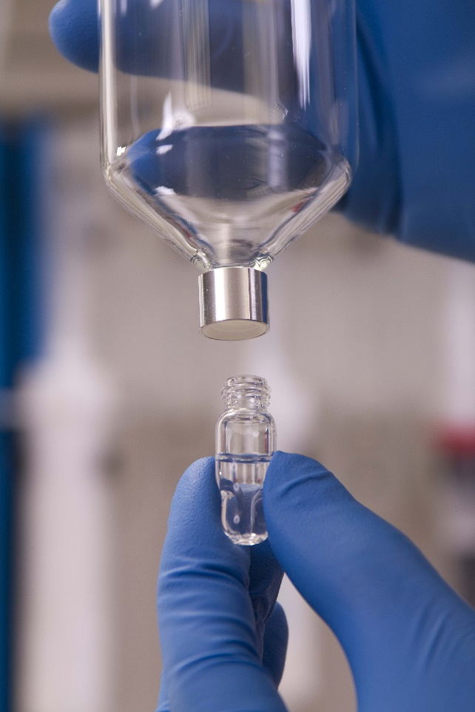
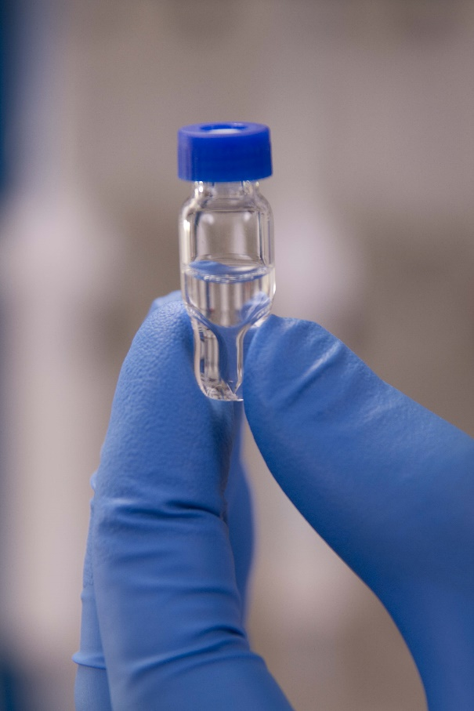
Glass Evaporation tube
GC vial

Slide 14
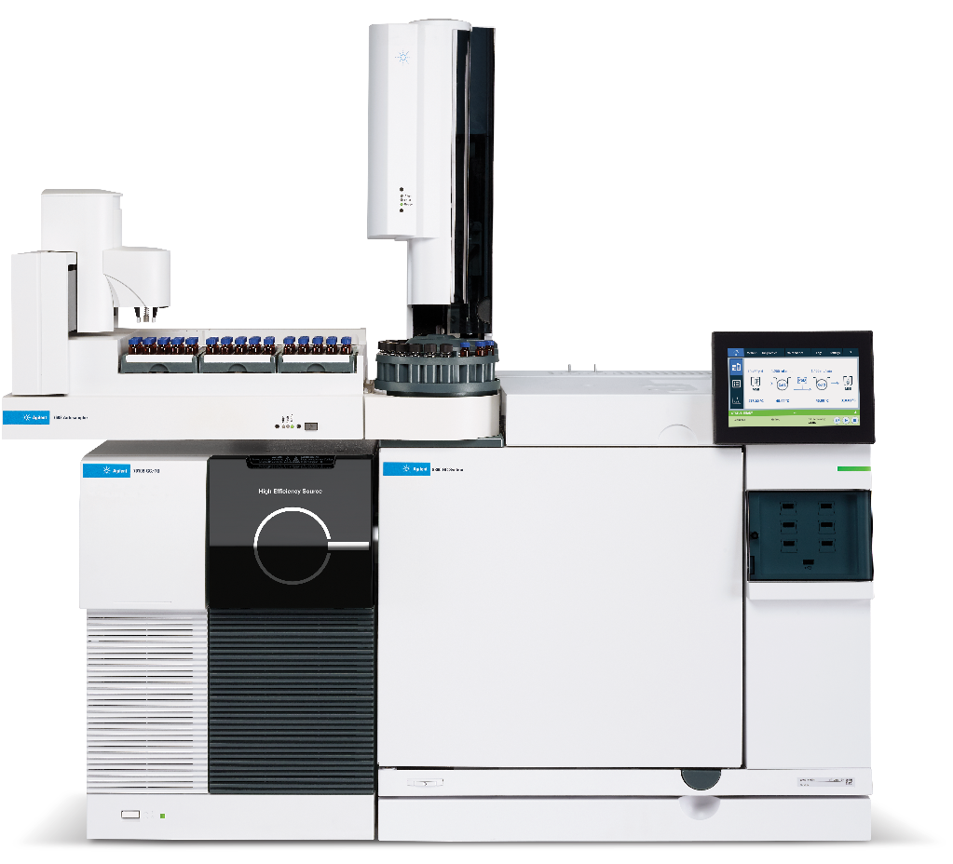
Using the GC-MS/MS
Agilent 7010

Slide 15
GC-MS/MS Precision

Slide 16
GC-MS/MS Limit of Detection

Slide 17
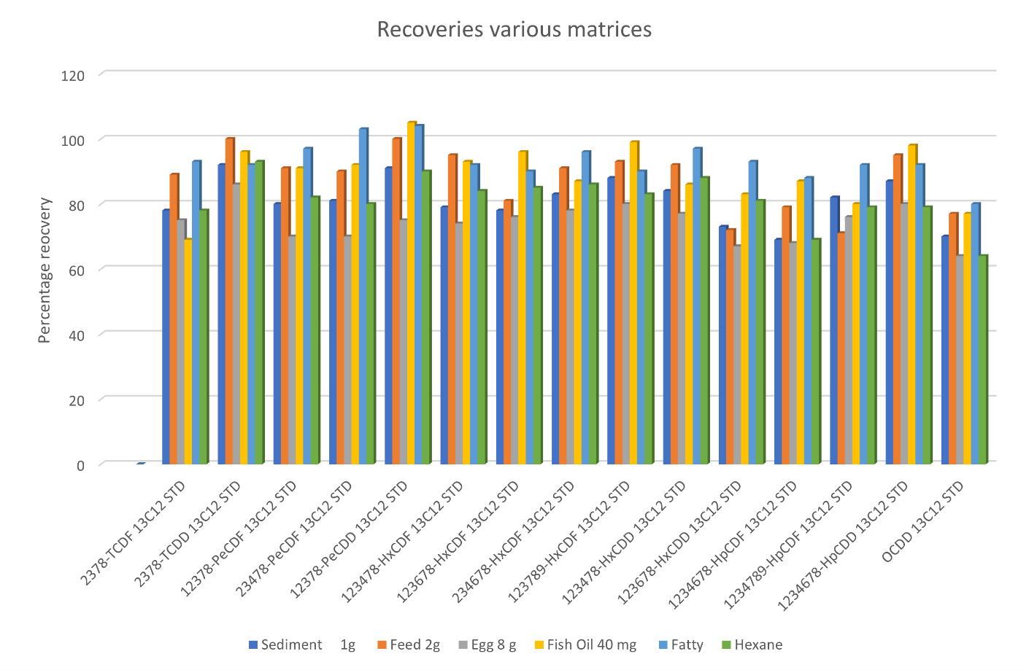
EP-110 13C Recoveries DD/F Matrices

Slide 18
EP-110 13C PCBs Recoveries Matrices

Slide 19
Semi-Automated Sample Cleanup
Simple to run, no computerized instrumentation
Fast: 30 - 45 min
Closed loop system to give a clean background, low level detection
Use certified pre-packaged columns
Green technology, only vacuum pump uses power
Economical column kits, choice of low fat and high fat column kits
No electronics or mechanical equipment to fail

Slide 20
Characteristics of Semi-Automated System (EZPrep)
Small Solvent Reservoirs
Small Solvent Reservoirs (40 mL)
Large Solvent
Reservoir 100/180 mL
Large Solvent Reservoirs
Stage 2 Manifold (collection)
3 Way Valve
Stage 1 Manifold (waste)
Turn Table

Slide 21
Stage 1: to waste
Solvents
Vacuum gauge
Waste
Column
assembly
Vacuum pump
Rotatory workstation

Slide 22
Stage 2: collect
Columns ready for elution
Manifold with collection tubes

Slide 23
Attributes
Closed loop system:
Eliminates background contaminants
No washing needed.
Capped solvent reservoirs
Optimized for solvent reduction while obtaining highest possible recoveries
Uses Hexane and Toluene, no Dichloromethane
Easy sample loading on top of silica column via syringe vial
Columns connect easy with SNAP connections

Slide 24
Procedure
Order of column assembly: Acid Silica-Carbon-Alumina
Conditioning all columns with hexane (waste)
Load sample
Elute columns with hexane and transfer all target compounds to carbon and alumina (waste)
Discard silica columns and remove carbon and alumina columns
Elute carbon and alumina individually with toluene (reverse)
Collect carbon fraction (PCDD/F and co-planary PCBs) and alumina fraction (mono- and di-ortho PCBs)

Slide 25
¹³C PCBs Recoveries EZPrep (%)

Slide 26
¹³C PCDD/F Recoveries EZPrep (%)

Slide 27
Comparison of Native Data with Automated System

Slide 28
13C PCBs recoveries in soil
10 g soil in toluene, n=6

Slide 29
Conclusions (1)
Combination of PLE, SuperVap and EP-110/EZPrep give flexibility to (semi-) automate extraction, concentration and cleanup for a wide variety of compounds.
PLE (Pressurized Liquid Extraction)
Reduced time:
Automated Pressurized Liquid Extraction (PLE) takes 60 min start-to-finish
Manual Soxhlet up to 24 h.
Up to 8 samples in Parallel
Reduced cost: less labor involved, shorter turnover time per sample, less electricity use for PLE than Soxhlet.
Reduced volume: less solvent used.
EP110
Uses No DCM
Low solvent use 100-250 mL
Total time from sample till data between 3-4.5 h
Clean up step time between 30 and 45 min
Modular 2 to 8 sample configurations in parallel
PLE and EP-110 can be configured in one system

Slide 30
Conclusions (2)
Ezprep Semi-Automated Sample Cleanup
Is a low solvent and fastest clean up system for Dioxins and PCBs (30 - 45 min)
High sample throughput → 18 samples/hour
6 samples in parallel per station
3 stations fit in one hood
System gives excellent recoveries for PCDD/F, PCB and PBDEs comparable to automated systems
Use of certified pre-packaged columns guarantees low native background

Slide 31
Agilent 7010 MS/MS Dioxin Analysis
Provides a complete Dioxin/PCB workflow with FMS Sample Prep Systems
Easy to Use and Implement
Cost Effective Alternative to High-Res Mass Spec
Lower instrumental purchase cost
Lower cost of real estate
Lower operational cost from lower training requirements and lower maintenance costs

Slide 32
Questions?
r.addink@fms-inc.com

