Slide 1
Quick and Reliable Method for Cleanup of All 209 PCBs in One Fraction in Environmental Samples
Fluid Management Systems
Watertown MA
Philip Bassignani, Ruud Addink, Philip Germansderfer
Fluid Management Systems
580 Pleasant Street, Watertown, MA 02472 , USA
www.fms-inc.com

Slide 2
Introduction (1)
POPs (PCDD/Fs, PCBs) continue to attract interest around the world due to strict regulations enforced in many countries
Rapid and quality sample clean up and analysis is needed for many laboratories processing samples
Processing times and cost are important considerations
In the US, EPA methods SW-846, 1668C and 8082A are used for PCBs

Slide 3
Introduction (2)
Sample extracts in DCM, hexane or toluene
Cleanup for analysis of all 209 PCBs in common in North America - extracts are often in toluene after Soxhlet Extraction
Dioxins and furans can also be run

Slide 4
Challenges of POPs Sample Prep
Labor intensive, prone to error
Compliance with regulatory procedures and accreditation (lengthy method validation)
Strict QA/QC requirements
Sample matrix complexity
Native background and interferences (can be orders of magnitude higher than analytes)
Pico/femto-gram analyses require ultra pure extract and excellent instrument sensitivity

Slide 5
Automated Sample Prep
Advantages of Automated Sample Prep
Rapid Turn Around Time: 30 to 45 Minutes for 6 Samples
Cleaner Background Interferences: Closed Loop System
Quality Results: Certified Pre-packaged Columns
Green Technology: Lower solvent and power use
QA/QC & Accreditation Requirements: Easier to Manage
Computerized Method: Instrumentation based prep

Slide 6
Manual Sample Prep
Advantages of Manual Sample Prep
Most labs use a Manual Methods for the following reasons:
No electronics or mechanical components to fail
No down time due to the system failure
No service contract
No capital equipment cost

Slide 7
Semi-Automated System
Specification:
Simple to run, no computerized instrumentation
Fast: 30 to 45 min
Closed loop system to give a clean background, low level detection
Use certified pre-packaged columns
Green technology, only vacuum pump uses power
Low solvents
Economical column kits, choice of low fat and high fat column kits
No capital equipment cost
No electronics or mechanical equipment to fail
No downtime

Slide 8
Characteristics of Semi-Automated System (EZPrep)
Small Solvent Reservoirs
Small Solvent Reservoirs (40 mL)
Large Solvent
Reservoir 100/180 mL
Large Solvent Reservoirs
Stage 2 Manifold (collection)
3 Way Valve
Stage 1 Manifold (waste)
Turn Table

Slide 9
Columns (1)
Classical Plus Acid
XL Capacity
Acid
Carbon
Alumina 4g
Alumina 6g
Classical Acid
High Capacity Acid

Slide 10
Columns (2)
Classical Kit
Classical Plus Kit
High Capacity Kit
XL Capacity Kit
Mini Kit

Slide 11
Stage 1 Manifold
Vacuum Gauge
Stopcock
Vacuum Relief Valve
Fitting to 3 Way Valve

Slide 12
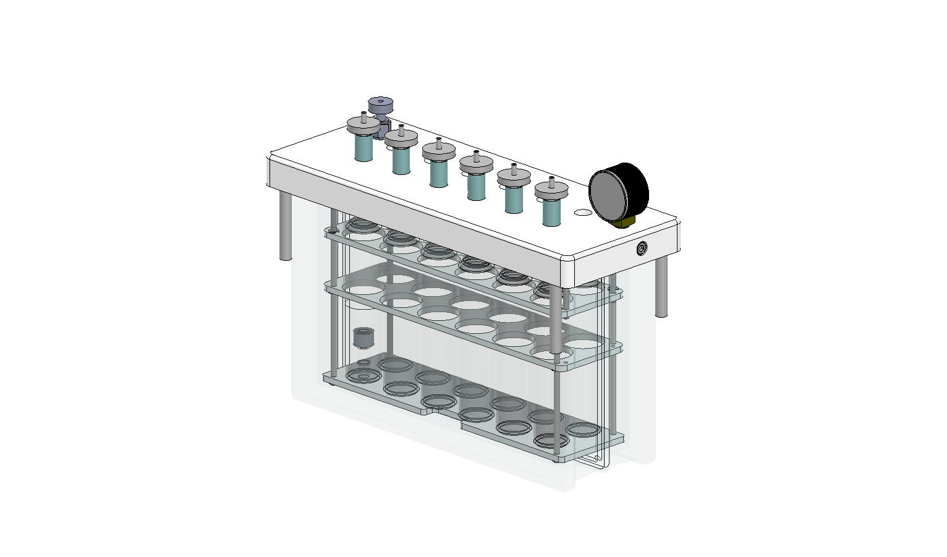
Stage 2 Manifold

Slide 13
Stage 1: to waste
Solvents
Vacuum gauge
Waste
Column
assembly
Vacuum pump
Rotatory work station

Slide 14
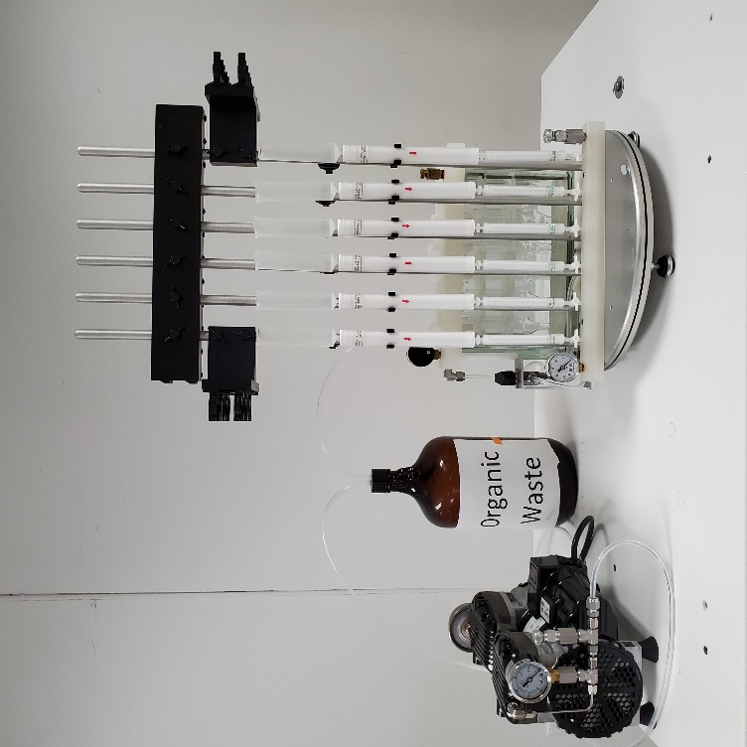
EZPrep Stage 1

Slide 15
Stage 2: collect
Columns ready for elution
Manifold with collection tubes

Slide 16
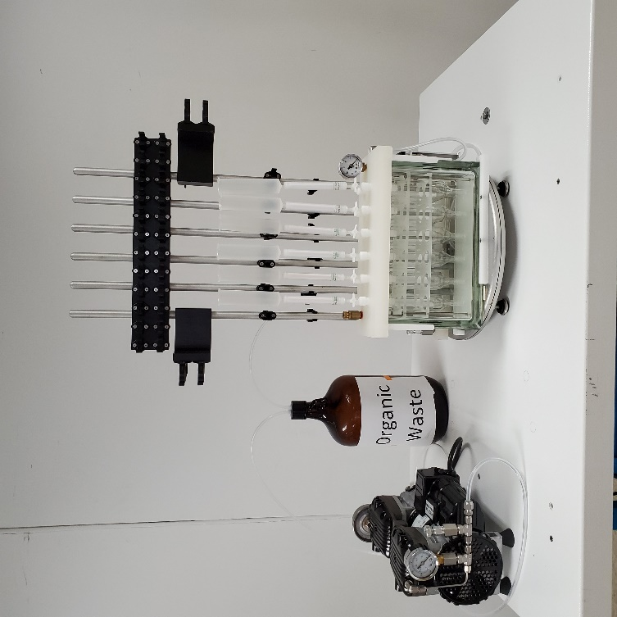
EZPrep Stage 2 Fractions

Slide 17
Attributes
Closed loop system:
Eliminates background contaminants
No washing needed.
Capped solvent reservoirs
Optimized for solvent reduction while obtaining highest possible recoveries
Easy sample loading on top of silica column via syringe vial
Columns connect easy with SNAP connections

Slide 18
Extracts in hexane - PCBs
Stage 1: Connect High Capacity Acid Silica and Alumina (no Carbon) and condition with 60 mL of hexane (vacuum, waste)
Stage 2: Load sample (in hexane, collect Fraction # 1), rinse loading vials with hexane, elute with 160 mL hexane (collect Fraction # 1), remove acid silica, elute alumina with 50 mL dichloromethane (collect Fraction # 1)
All 209 PCBs are now in Fraction # 1

Slide 19
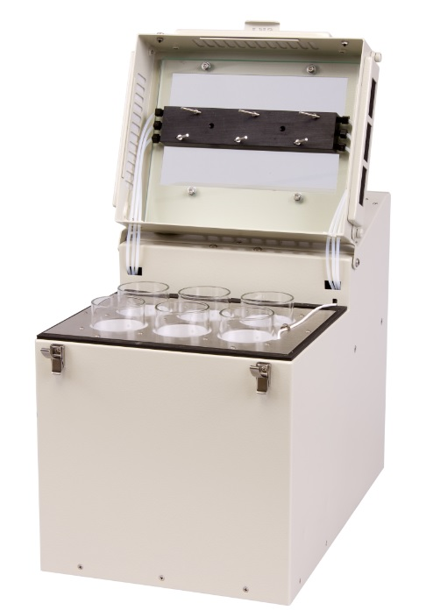
SuperVap 6 Concentrator 250 mLs

Slide 20
SuperVap Concentration/Evaporation
System pre-heated to 55-60 ºC.
Samples evaporated at stable T under 5-6 psi nitrogen.
1 mL extract vial transferred to GC vial (can have direct-to-vial feature).
Recovery standards added (nonane/dodecane).
Extract taken to 10 uL volume with a gentle stream of nitrogen at ambient temperature.

Slide 21
SuperVap 24 position GC vial Concentrator

Slide 22
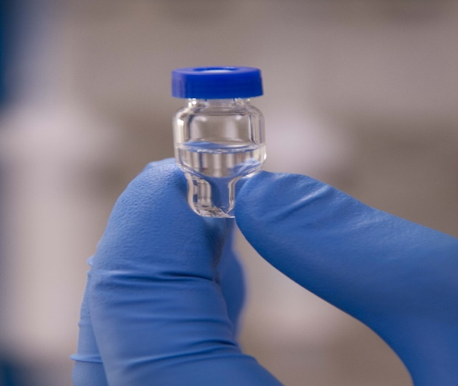
Direct-to-Vial
GC vial

Slide 23
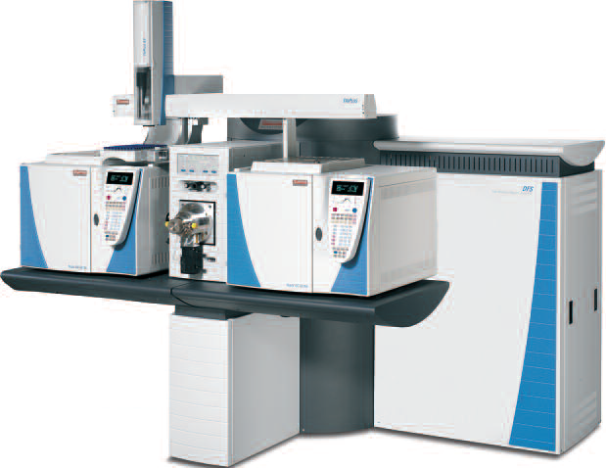
DFS HRGC/HRMS

Slide 24
Native PCBs in Serum extract

Slide 25
Native PCBs in Soil extract

Slide 26
Extracts in toluene -PCBs
Stage 1: Connect High Capacity Acid Silica and Alumina (no Carbon) and condition with 60 mL of hexane (vacuum, waste)
Stage 2: Load sample (in 2-10 mL toluene, collect Fraction # 1), rinse loading vials with hexane, elute with 60 mL hexane (collect Fraction # 1), remove acid silica, elute alumina with 50 mL dichloromethane (collect Fraction # 1)
All 209 PCBs are now in Fraction # 1

Slide 27
13C recoveries PCBs soil
10 g soil in toluene, n=6

Slide 28
13C recoveries PCBs salmon
2 g salmon in toluene, n=6

Slide 29
Column Kits with various fat removal capacities for samples in hexane
 |  | STAGE 1 |  |  | STAGE 2
 |  |  |  |  | PCBs
 | Fat Removal | Hexane | Hexane | Hexane | DCM
Column kits | Capacity | conditioning (mL) | sample volume (mL) | Elute Silica (mL) | Alumina (mL)
Classical Plus | 1.0 g | 20 | 30 | 100 | 50
High Capacity | 2.5 g | 40 | 30 | 160 | 50
Extra high Capacity | 5.0 g | 60 | 30 | 180 | 50

Slide 30
Conclusions (1)
Samples in toluene (environmental, food): 2-10 mL toluene, collect all 209 PCBs in one fraction using hexane followed by DCM
Reduced hexane volume needed for silica column because of presence toluene
Works also for samples in hexane but more hexane needed in that case for silica elution (“toluene effect” not present)
EZPrep suitable for environmental and food analyses in toluene as solvent. Also suitable for samples in hexane
High sample throughput → 18 samples/hour
6 samples in parallel per station
3 stations fit in one hood

Slide 31
Conclusions (2)
System gives excellent recoveries for PCBs comparable to automated systems
Use of certified pre-packaged columns guarantees low native background
No worries about breakdown or downtime
No washing needed
No cross-contamination
Low cost

Slide 32
Questions
Contact us at:
raddink@fms-inc.com (Ruud Addink)
thall@fms-inc.com (Tom Hall)

